Slide 1
Energy Bingo

Slide 2
Draw a grid of 9 squares like the
one opposite
Choose 9 answers from the next screen
and put one in each square

Slide 3
Chemical, Potential, Solar, Nuclear, Acid, Dynamo, Sound, Joule, Mechanical
Battery, Work, Kinetic, Electrical, Elastic, the Sun, Heat, Thermometer, Transformed
Gravity, Magnetic, Lamp

Slide 4
Cross off the answers as the questions matching them appear on the slides, when you have crossed all nine off, shout:-
Bingo!

Slide 5
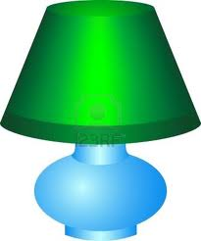
What device changes electrical energy into heat and light?

Slide 6
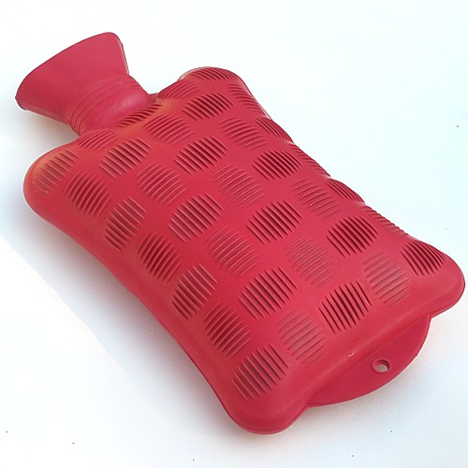
What kind of energy is stored in a hot water bottle?

Slide 7
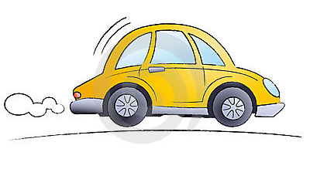
What kind of energy does a moving object have?

Slide 8
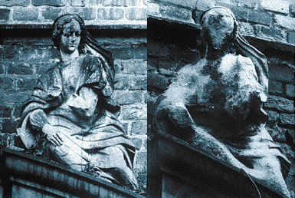
This type of rain erodes old statues and buildings?

Slide 9
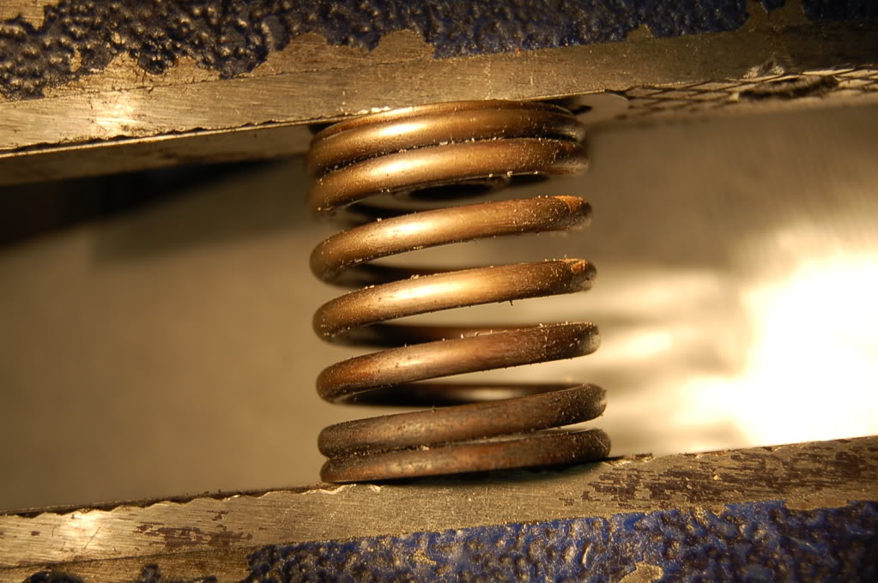
What type of energy does a compressed spring have?

Slide 10
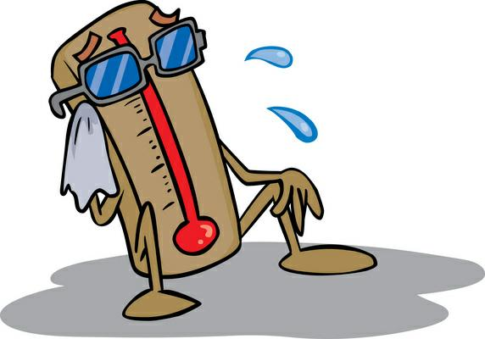
What device measures temperature?

Slide 11

What type of energy is stored in food?

Slide 12
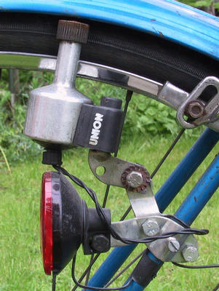
What device changes kinetic energy into electrical energy?

Slide 13
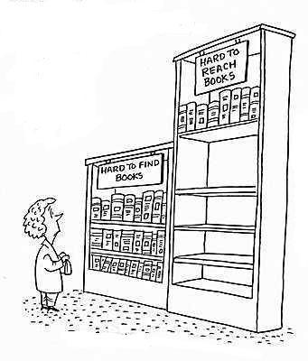
A book resting on a high shelf has this type of energy?

Slide 14
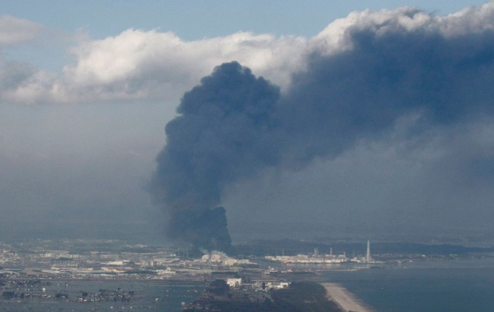
What type of energy was accidentely released at the disaster in Fukushima Japan?

Slide 15
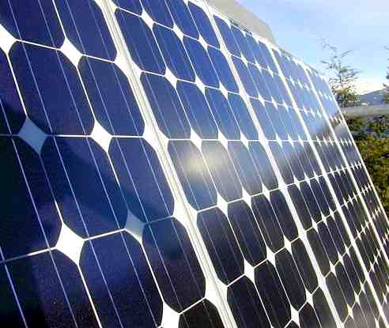
What type of panel is this?

Slide 16
We need energy to do what?

Slide 17
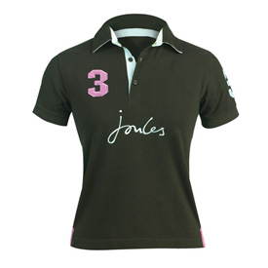
What's the unit of energy?

Slide 18

The source of nearly all the energy on Earth?

Slide 19
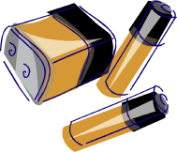
What device converts chemical energy into electrical?

Slide 20

What kind of energy is produced by a loudspeaker?

Slide 21
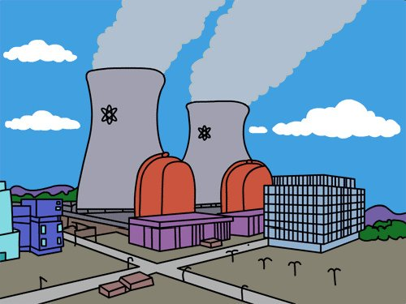
What is the useful energy created in a power station?

Slide 22
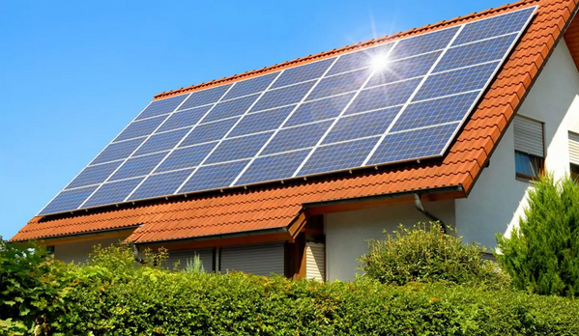
Energy is ___________ when sunlight is converted to electricity?

Slide 23
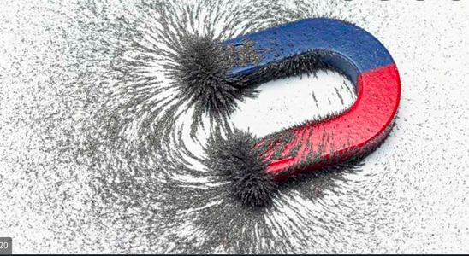
A type of energy that is produced by magnets

Slide 24
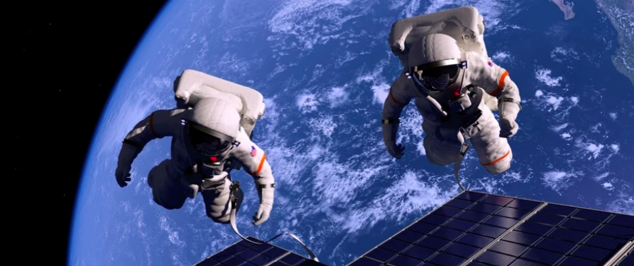
Energy is stored when objects are lifted above the ground
This type of energy is due to
_______________

Slide 25
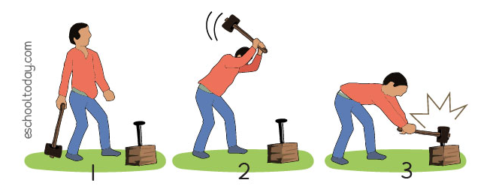
Chemical energy is converted to
__________ energy

